Slide 1
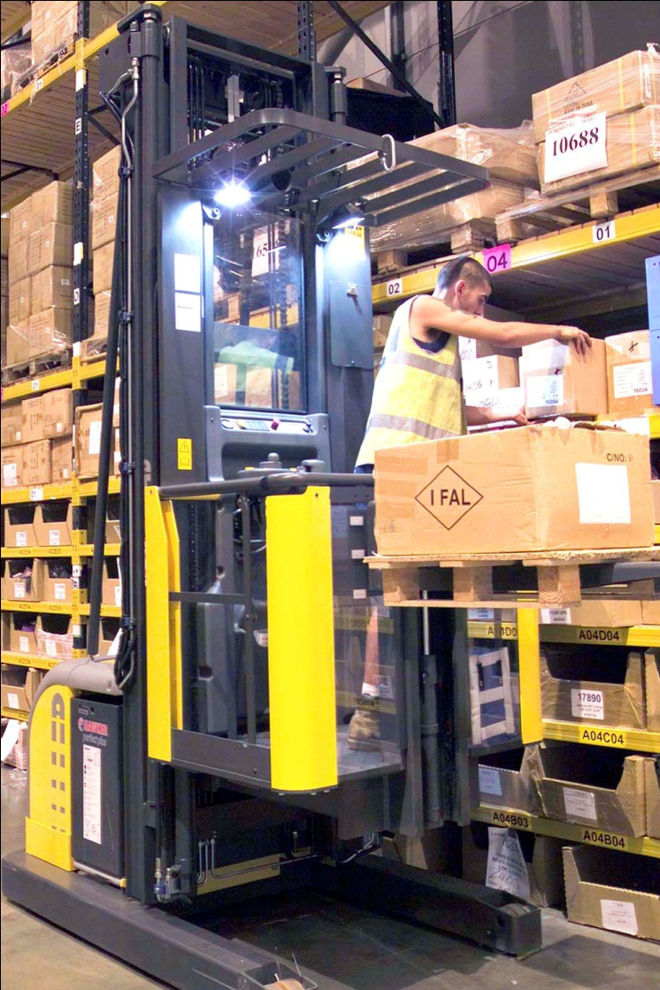

Slide 2
Stock Handler
Create daily plans for stock to be gather
Figure out most efficient routes to take to gather all products for shipment
Recording and monitoring of inconsistencies in stock levels
Track speed of each of the workers

Slide 3


Slide 4
Shipper & Receiver
Check and assign upcoming shipments
Record outgoing shipment information
Track pallet contents
Input information for incoming products
Check warehouse capacity
Check shipments to be shipped to create space

Slide 5


Slide 6
Manager
It is a management and reporting system
Product listing, purchase order listing and shipping listing, including basic information about item name, price, and time.
Statistic report, employee report.

Slide 7



Slide 8
Database
Set up MySQL database to record warehouse information
Set up Neo4j Graph Database to record warehouse layout

Slide 9
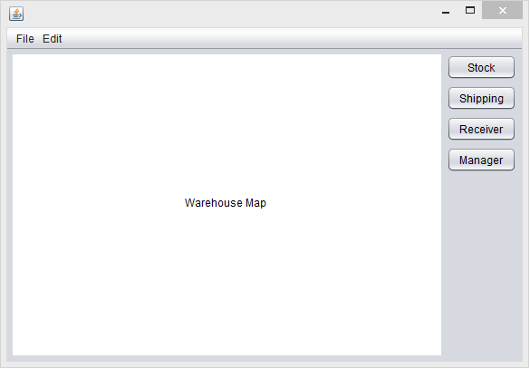
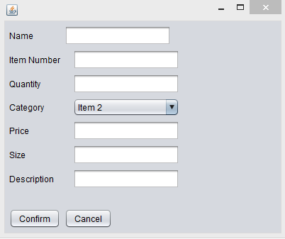
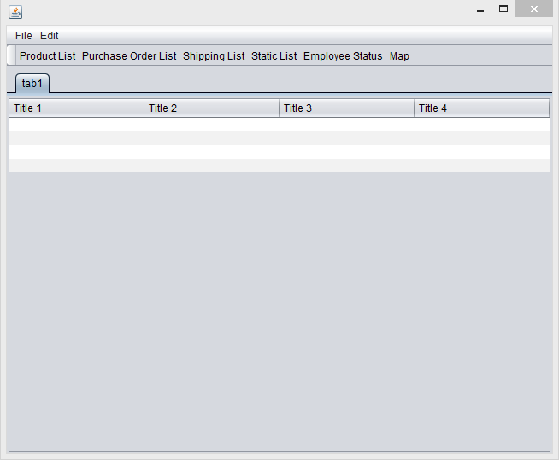
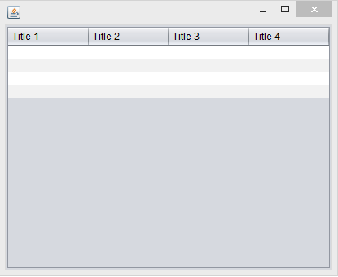

Slide 10
GUI
Easier and convenience to use
Improving customer using experience

Slide 11
No breakdown of the work
Cooperate closely
Discuss and Find out solution

